Slide 1
Checkpoint 2 & 3
Yichen Sheng

Slide 2
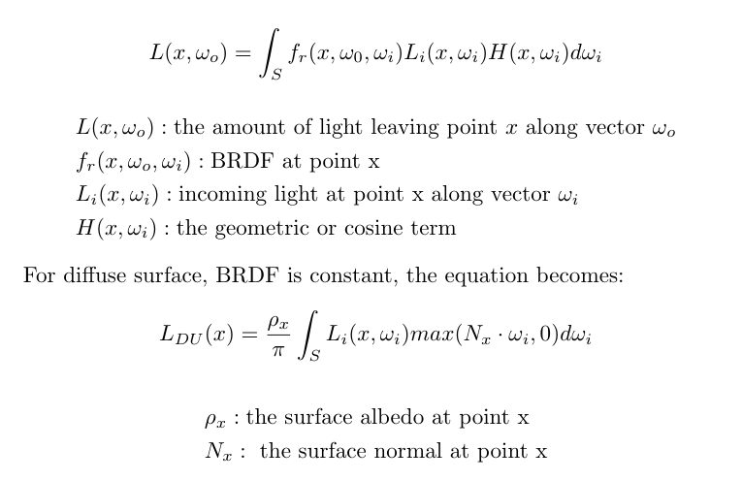
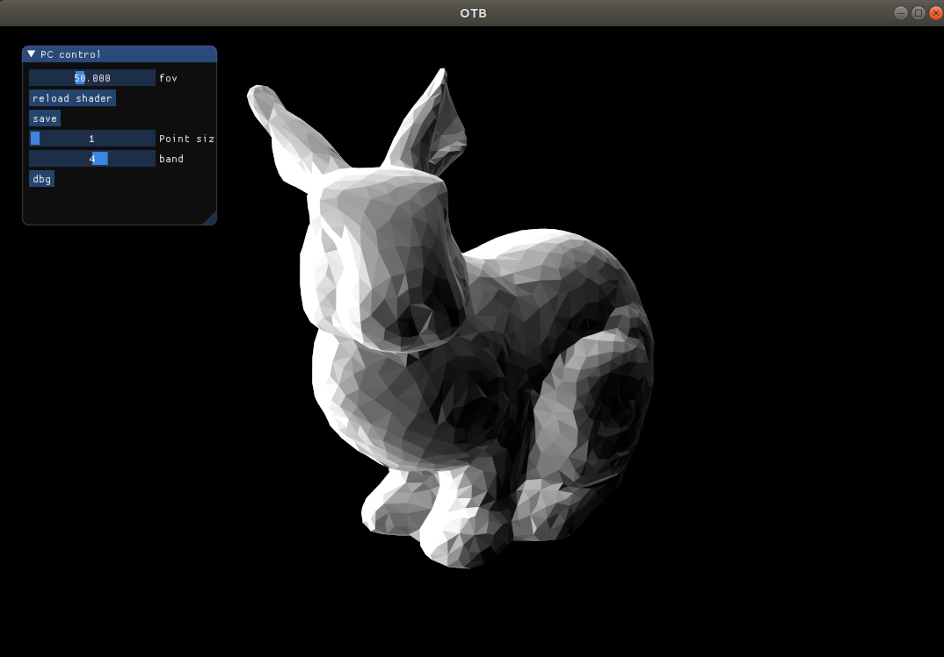
Diffuse (unshadowed) SH rendering (4 bands)

Slide 3
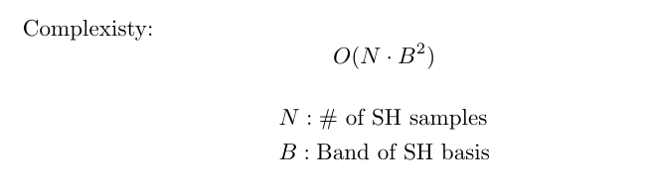
Diffuse (unshadowed) SH rendering (4 bands)
For each vertex:

Slide 4
Diffuse (unshadowed) SH rendering

Slide 5
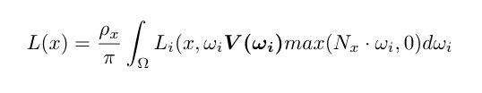
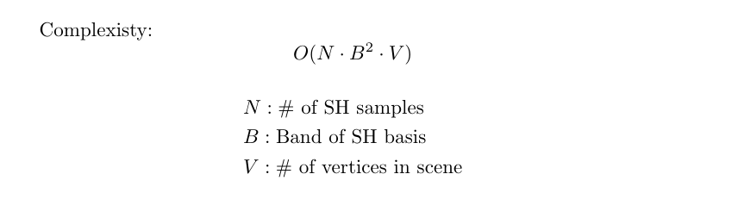
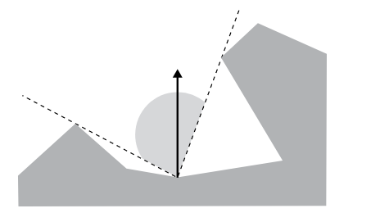
Diffuse (shadowed) SH rendering

Slide 6
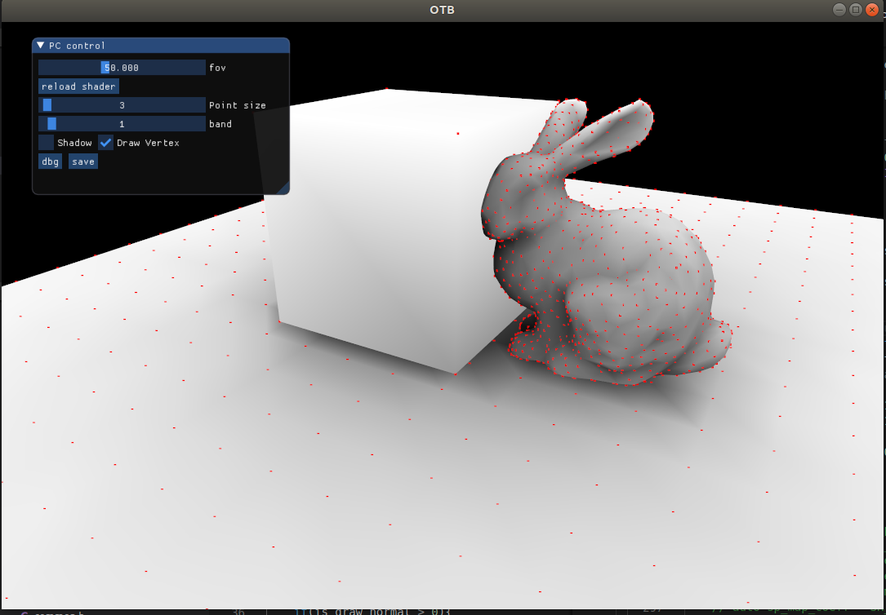
Visibility

Slide 7
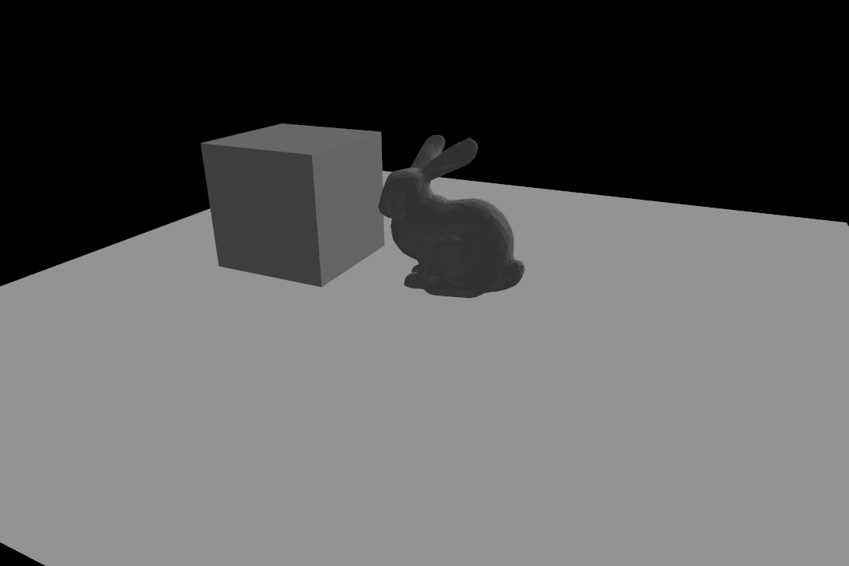
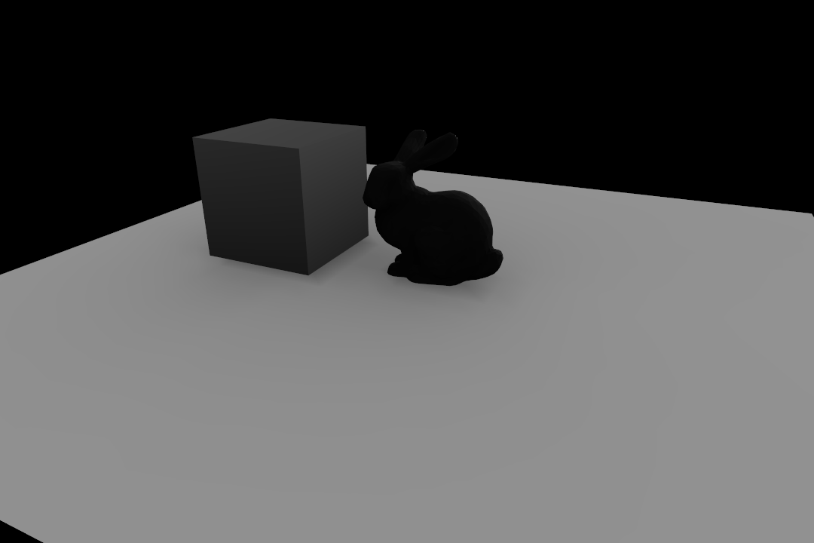
Diffuse(shadowed) SH rendering

Slide 8
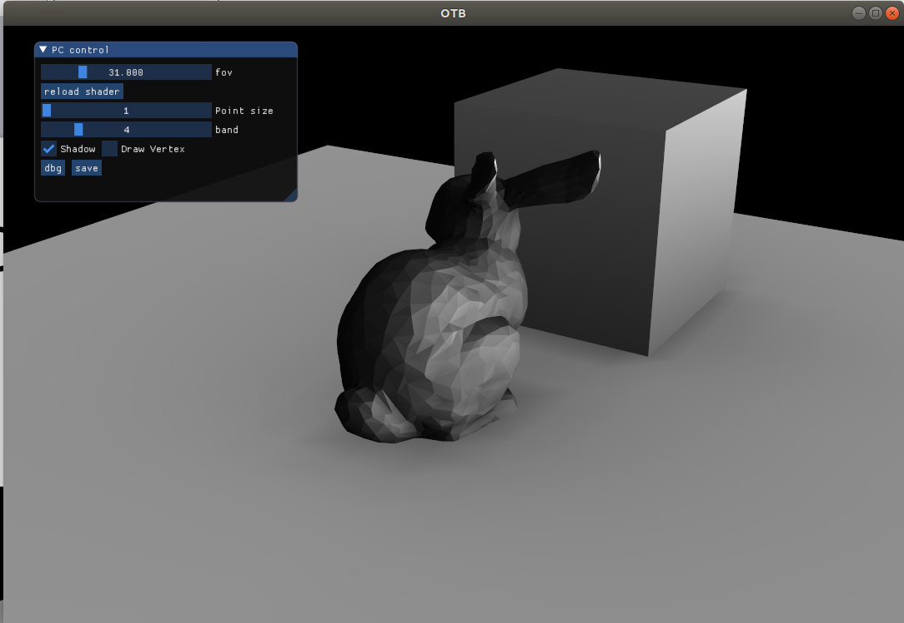
Diffuse(shadowed) SH rendering

Slide 9
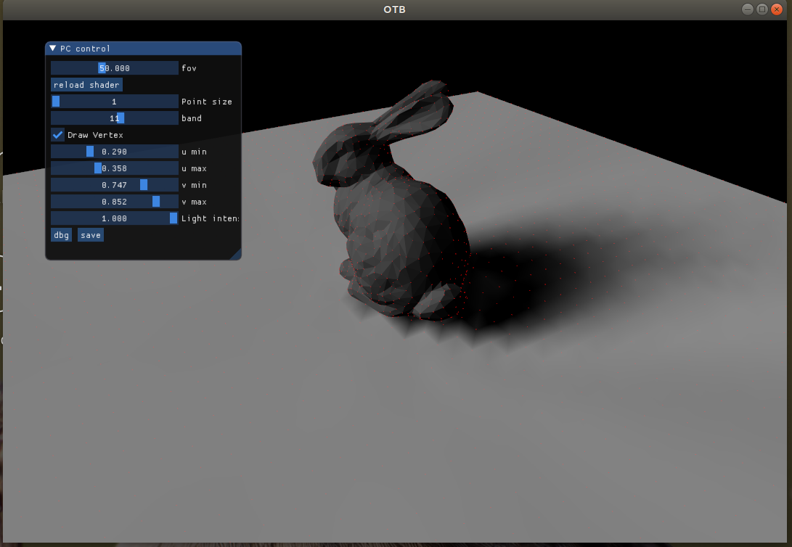
Exps
Cast shadows onto the plane.
Plot shadows w.r.t. SH bands.
Live demo!

Slide 10
Conclusions
Pros:
Efficient rendering in runtime
General basis for integral of spherical surface
Low level details from low order basis
Cons:
1. It's hard to use SH to render hard shadows
even use 11 band (121 bases)
2. Shadow resolution depends on vertices of shadow
receiver
3. Visibility test is expensive to compute

Slide 11
Exp on bands (1~11)

